Slide 1

Team 1 - AceTeam
Haoran Dai
Xiaocheng Kang
Qinchen Gu
Bhargav Gundapaneni
Huanzhou Wang

Slide 2

Team Members
Notes:
Allow me to introduce our team again, Haoran is our team leader & security leader…. etc.

Slide 3
Team Members
Haoran Dai
- Team & Security Leader
Xiaocheng Kang
- Requirement & Configuration Leader
Qinchen Gu
– Q & A Leader
Bhargav Gundapaneni
- Implementation Leader
Huanzhou Wang
- Design Leader
Notes:
Allow me to introduce our team again, Haoran is our team leader & security leader…. etc.

Slide 4
Technical Stacks
Database Preliminary Design
Function Modules
Content
Project Introduction

Slide 5
Introduction
Project Introduction
Project Planning

Slide 6
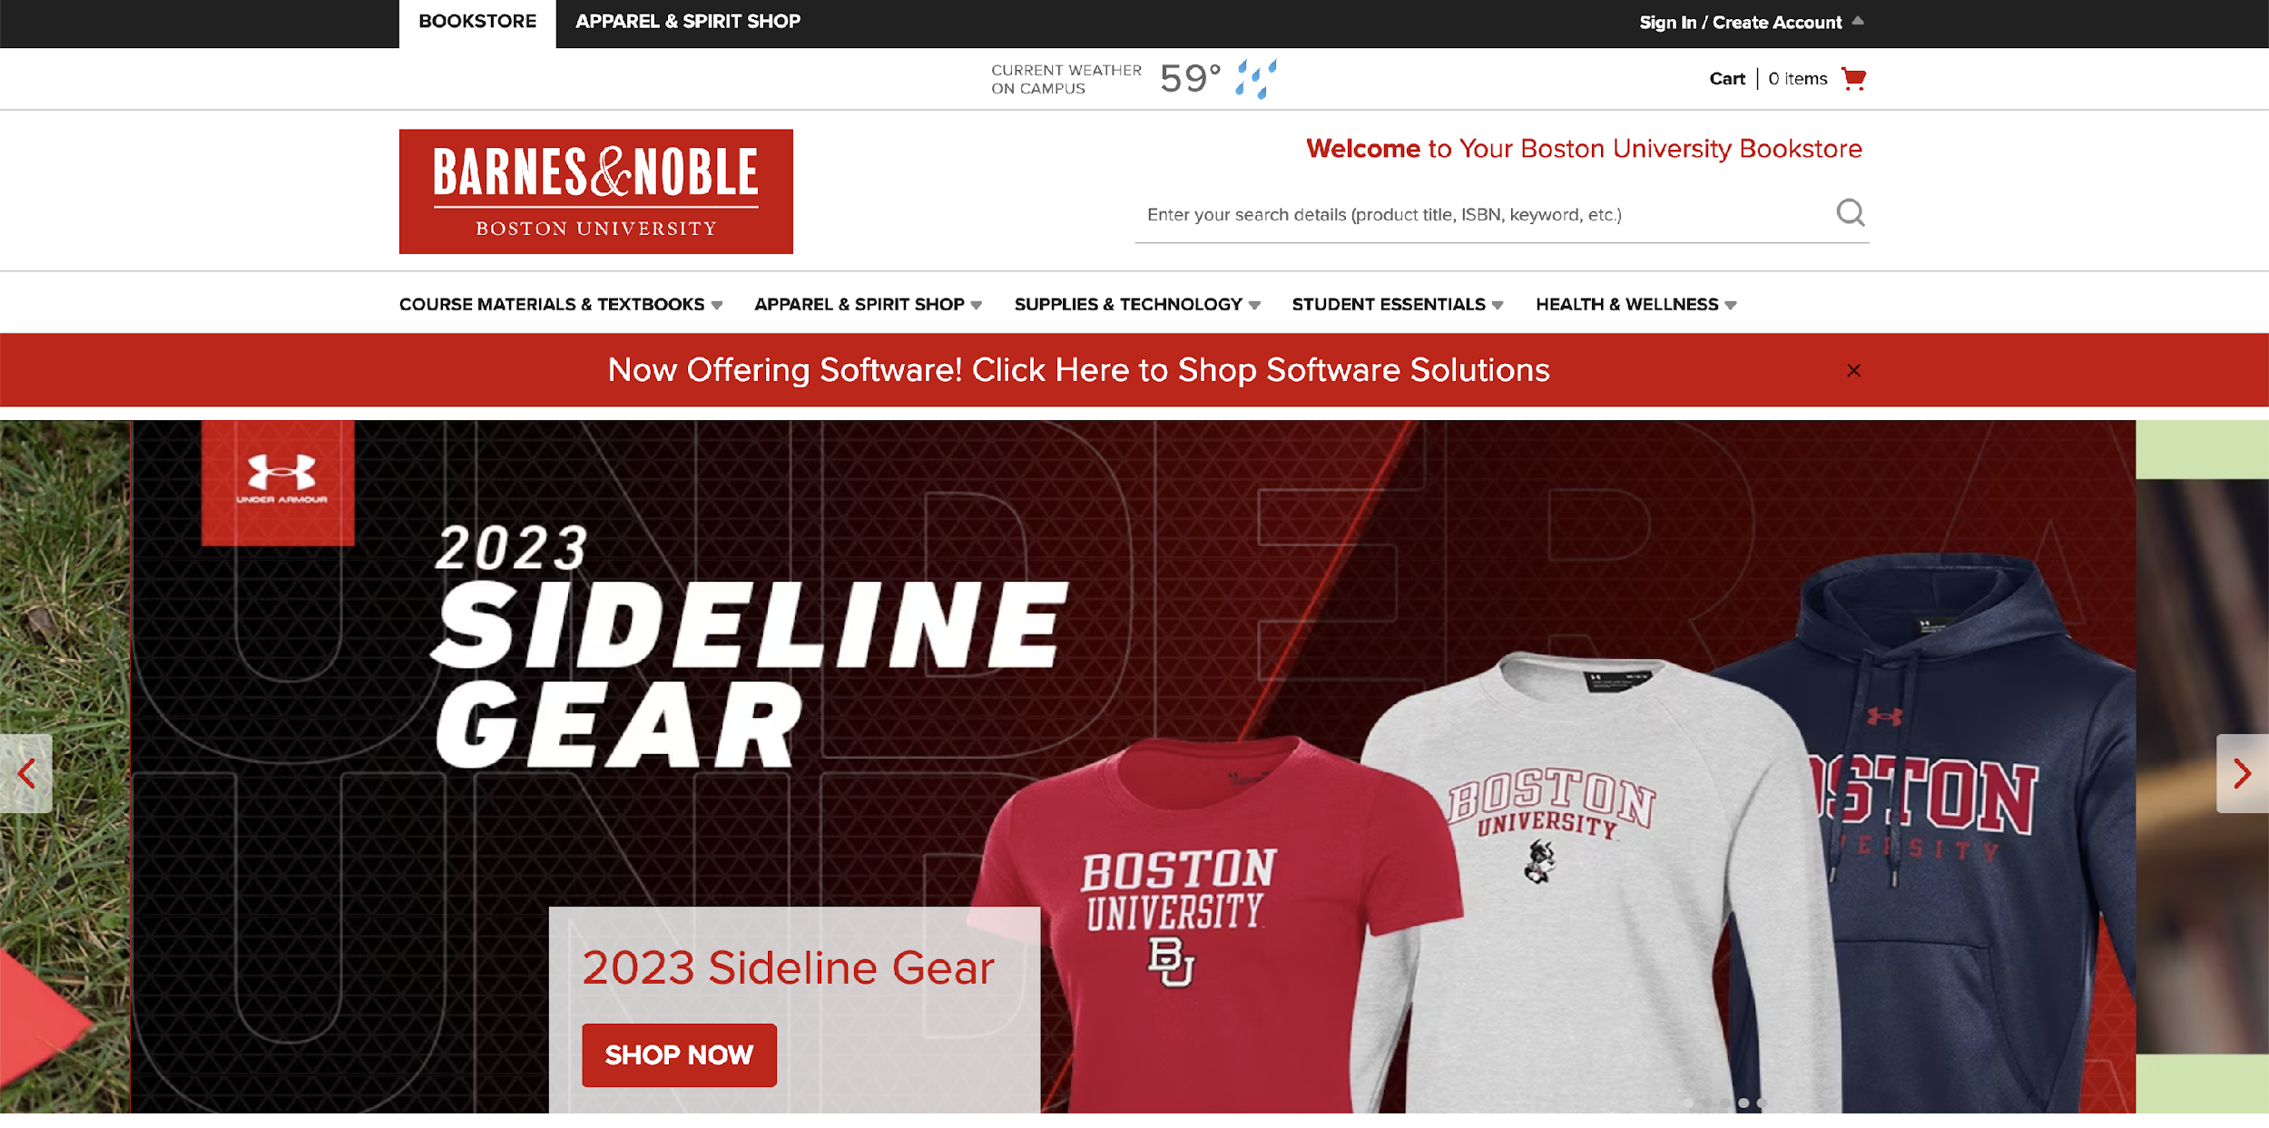
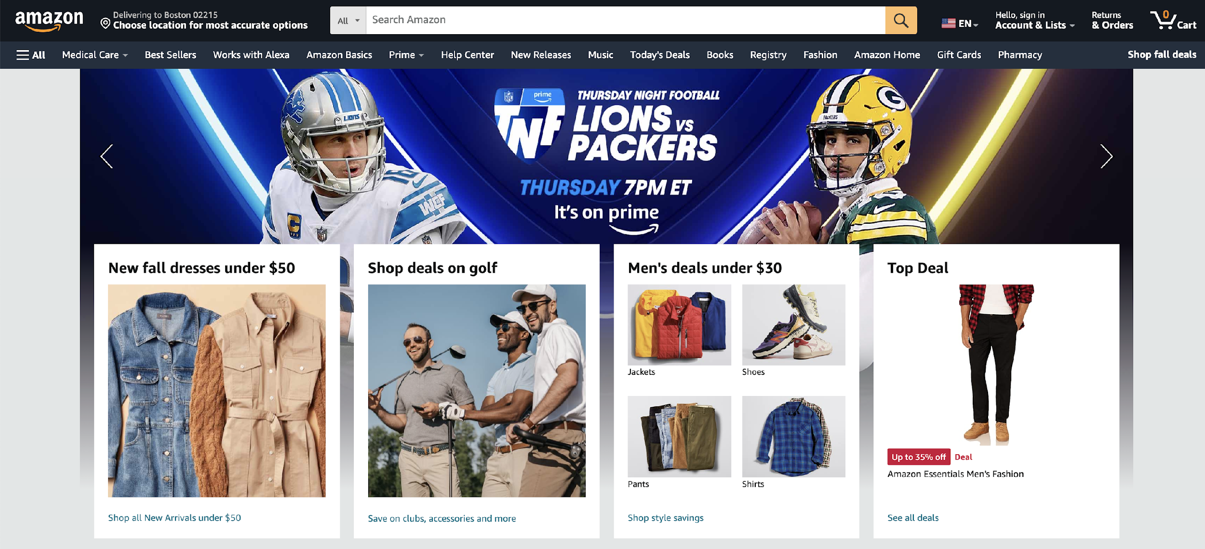
Project Introduction
Notes:
For our proj, we want to build a website which about marketing. For example, Amazon. New products will be our main products to sell post on our website. However, we wanna create a used products part for those who want to buy used products by less money.

Slide 7
Project Introduction
Terriers Shopping Mall Product
New Product
Bounty Tasks
Used Product
Web Crawler
Admin Upload
User Upload
Notes:
For our proj, we want to build a website which about marketing. For example, Amazon. New products will be our main products to sell post on our website. However, we wanna create a used products part for those who want to buy used products by less money.

Slide 8
Purpose
Customers
Students
Buy and sell second-hand items
Purchase BU themed products
A Unified
Platform
Post posts and create communities on campus
Learn about BU communities' culture
Bounty Tasks
Notes:
So for our target audience, they should be all the customers who wanna do online shopping. Also, some customers want to find a way to sell their products which cannot return and didn’t use for a lot of times. How our website works? Suppliers and customers can post their goods on our website, and our website can provide customers with a way to find what they are looking for. For current market scenario, online shopping becomes the most popular way for customers. Online shopping makes it convenience for buyers and sellers.

Slide 9
Project Planning
Iteration 0:
Project Intro/Project Plan/Purpose
Iteration 1:
Template Web/Database
Iteration 2:
Shopping Website/Checking/Securing
Iteration 3:
Template for IOS System / Testing
Notes:
Here is our project planning, today is iteration 0, we will introduce our project, show how we will do for our website, and show the technical things which we will use. For iteration 1, we are planning to complete our website template, and build a database for it. For iteration 2, we are wondering we can complete our shopping website, and do the checking, securing to see it is working. At this time, our iteration 3 might wanna do a template for IOS system, but if we got problems on our website, we will focus on them first.

Slide 10
Technical Stacks
Technology Stacks Plan To Use
Advantages & Disadvantages For Every Technical Stacks

Slide 11
General Advantages of the Separation of Front and Back Ends
Scalability
Each layer can scale independently based on its own needs
Flexibility
Teams can choose the best technology for their specific needs
Maintainability
Easier to debug, update, or refactor one layer without affecting the others
Requires coordination between different teams working on frontend and backend, and members can learn better from the project

Slide 12

Backends - Springboot
Characteristics:
Java-based framework for building stand-alone, production-ready applications.
Convention over configuration approach.
Embedded Tomcat, Jetty, or Undertow servers.
Advantages:
Quick setup and bootstrapping of new projects.
Wide range of plugins and dependencies for various tasks.
Integrated with the larger Spring ecosystem.
Disadvantages:
Might be overkill for simple applications.
Learning curve for developers unfamiliar with the Spring ecosystem.

Slide 13

Frontend - React
Characteristics:
JavaScript library for building user interfaces.
Component-based architecture.
Virtual DOM for efficient updates and rendering.
Advantages:
Reusable components lead to faster development.
Strong community support and rich ecosystem.
Seamless integration with various backend technologies.
Disadvantages:
Only covers the view layer, so additional libraries might be needed.
JSX syntax might be unfamiliar to some developers.

Slide 14

Data Resource - Web Crawler
Characteristics:
Automated web navigation & content download.
Adherence to robots.txt, so we can customize it.
Handles duplicate content & rate limits.
Advantages:
Efficient data collection.
Tailored data gathering (e.g., product prices).
Competitive analysis & SEO insights.
Disadvantages:
Legal & ethical concerns.
Maintenance due to website changes.
Potential to overload servers.

Slide 15
Database Design
Project Entity & Database Introduction

Slide 16

Database - MongoDB
Characteristics:
NoSQL database.
Document-oriented with BSON format.
Schema-less nature
Advantages:
Scalability and flexibility in handling large volumes of data.
No rigid schema, allowing for varied data structures.
Distributed architecture for high availability.
Disadvantages:
Lack of ACID transactions (though this has improved in recent versions).
Might not be suitable for complex relational data models.

Slide 17
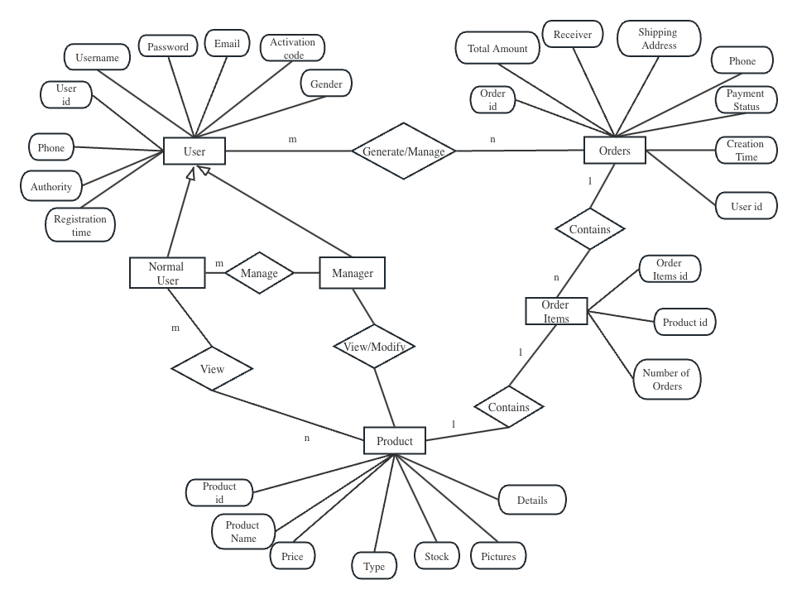
Database Design

Slide 18
Function Modules
Expected Project Function Modules

Slide 19
User
Mgmt
Product Mgmt
Cart & Checkout
Order Mgmt
Review & Rating
Com Module

Slide 20

User Management
User Registration Process and Data Validation
Overview of the registration process
Importance of data validation for user inputs
Examples of validation checks (e.g., email format, password complexity)
Login Mechanism and Security Measures
Description of the login process
Explanation of security measures (e.g., encryption, CAPTCHA)
Importance of user authentication
Profile Management Features
Features users can access to manage their profiles
Profile picture upload, password change, personal information update

Slide 21

Product Management
Product Listing with Search and Filter
Displaying products for users to browse
Search functionality for finding specific products
Filters for refining search results (e.g., by category, price)
Product Details and Specifications
Showing detailed information about a product
Specifications such as size, color, weight, and materials
High-quality images and product descriptions
Product Categorization and Tagging
Organizing products into categories
Use of tags to enhance product discoverability
Examples of categories and tags

Slide 22

Cart & Checkout
Process of Adding/Removing Products to / from Cart
Step-by-step explanation of adding items to the cart
How users can remove items from the cart
Visual representation of the shopping cart
Checkout Process, Payment Gateways, and Security
Overview of the checkout process
Payment gateway options (e.g., credit card, PayPal)
Ensuring secure transactions (SSL, encryption)

Slide 23

Order Management
Order Placement and Confirmation
Explaining how users place orders
Confirmation messages and emails
Importance of order confirmation for users
Order Tracking and Status Updates
How users can track their orders
Different order statuses (e.g., processing, shipped, delivered)
Real-time updates and notifications
Order History and Reordering Features
Accessing order history for reference
Convenient reordering options for returning customers
Benefits of order history for both users and the business

Slide 24

Reviews & Ratings
Mechanism for Users to Leave Reviews and Ratings
How users can submit reviews and ratings
Providing guidelines for meaningful feedback
Encouraging user participation
Display of Reviews and Ratings on Product Pages
Importance of user-generated content
Examples of how reviews and ratings are displayed
Impact on user decision-making
Feedback Collection and Analysis
Methods for collecting user feedback
Analyzing feedback for product improvement
Demonstrating the value of user input

Slide 25

Communication
Mechanism for Users to Talk with Officers
Functionality: The communication module should allow customers to send queries, feedback, or complaints. It should also allow administrators to respond to these queries.
Notifications: Both customers and administrators should receive notifications for new messages or responses.

Slide 26
Thanks For Listening!

